Slide 1
Teaching cybersecurity: a practical path to increase user’s awareness
INJECTION – BEGINNER LEVEL

Slide 2
INJECTION
Injection is an attacker’s attempt to send data to an application in a way that will change the meaning of commands being sent to an interpreter

Slide 3
UNTRUSTED DATA
Input that can be manipulated to contain a web attack payload
Parameters in HTTP requests
Form fields
Headers
Cookies

Slide 4
CONSEQUENCES
Data breaches
Loss of control over the application

Slide 5
Cross site SCRIPTING ATTACK
Malicious scripts are injected into otherwise trusted websites

Slide 6
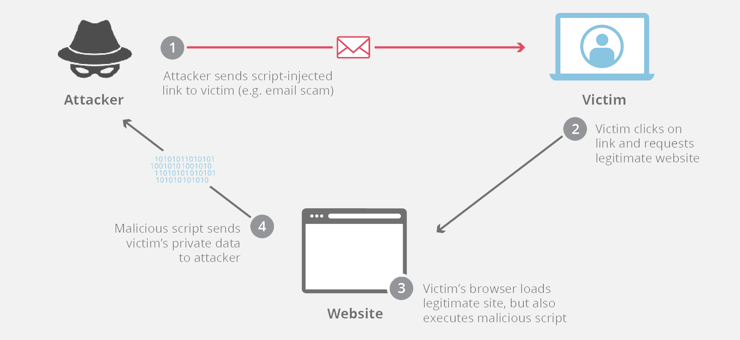
https://www.cloudflare.com/img/learning/security/threats/cross-site-scripting/xss-attack.png.

Slide 7
CROSS SITE SCRIPTING ATTACKs OCCUR WHEN
Data enters a web application through an untrusted source, most frequently a web request
Data is included in dynamic content sent to a web browser without being validated

Slide 8
SQL INJECTION ATTACK
Injection of a malicious SQL query via the input data from the client to the application

Slide 9
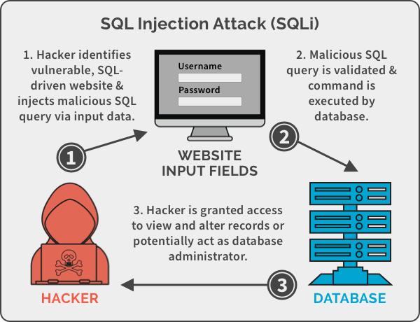
https://spanning.com/wp-content/uploads/2019/07/SQL-injection-attack-example.png.

Slide 10
CONSEQUENCES
Read data from the database
Modify data
Execute admin operations
Issue commands to the OS

Slide 11
TESTING FOR SQL injection VULNERABILITIES
Submitting specific characters
Submitting Boolean conditions
Submitting payloads to trigger time delays

Slide 12
HAVE FUN WITH SOME PRACTICAL EXERCISES
Complete the suggested exercises of the Beginner Level of the Injection learning path

Slide 13
QUESTIONS
In this little section you will find some simple questions to test your comprehension of the topic.
What is the main vehicle for injection attacks?
Which is the main cause of injection attacks?
Briefly explain how an XSS attack can occur.
Briefly explain the possible consequences of a SQL injection attack.
5. How can SQLi vulnerability be detected?

